Slide 1
Nonlinear Dynamical Systems Workshop
Monday Afternoon

Slide 2
Overview (1:30)
Inference
Self-Organization
Burstiness
Interlude: Shapes
Power-laws (if time…if not, then tomorrow morning)

Slide 3
Nonparametric Inference (1:30)
When to use nonparametric methods?
Non-normal (Shapiro-Wilk test, p < 0.1)
Nonlinear good practice: NEVER transform variables!
Heteroskedastic (summary(…) or lmtest::bptest(…) after regression)
Small n (How small is small?)
Me, I just default to the nonparametrics
Sure, I lose some power, but I don’t care…you’ll see why later in the week
Wilcoxon (Mann-Whitney-U)
wilcox.test(…)
Permutation ANOVA
lmPerm::aovp(…)
Is lmPerm in your buffet? On your plate?
Notes:
Post-hocs:
dunn.test::dunn.test() for Dunn’s test
Pairwise Wilcoxon (with Bonferroni)
Others include Conover test & Nemenyi test

Slide 4
Nonparametric inference
Example: NDSData4
Two columns: the anxiety score and the group (low or high shape)
Normality: Shapiro-Wilk (for each of the two conditions!)
Homoskedasticity: summary(…) or sd(…) plus hist(…)
wilcox.test(…)
summary(aovp(Anxiety ~ Group,
data = read.csv("https://bit.ly/NDSData4")))
Cf. aov(…) or t.test(…)

Slide 5
CYO: Nonparametric inference (1:50)
CYO: Compare these methods and discuss with your partner
aov()
t.test()
aovp()
wilcox.test()
Datasets
NDSData5
NDSData6

Slide 6
Self-Organization (2:15)

Slide 7
Self-Organization (2:15)
Self-Organization
Local interactions and global order
Example: Traffic jams
Why do we have them?
Exogenous vs. Endogenous approaches
Exogenous: Crash
Endogenous: Propagation of braking above critical density
Emergent behaviors can arise
Can’t be reduced to their parts, even as they may be constrained by those parts
Domains of behavior

Slide 8
Empirical Self-Organization (2:30)
Typically requires data that can exhibit a pattern
Time series data (e.g., the seasons, although they aren’t SO)
Spatial data (e.g., Giant’s Causeway)
Two metrics (for this afternoon)
Burstiness
Power-law distribution
Often aided by orbital decomposition

Slide 9
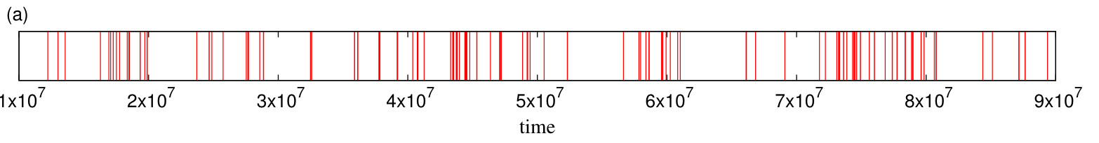
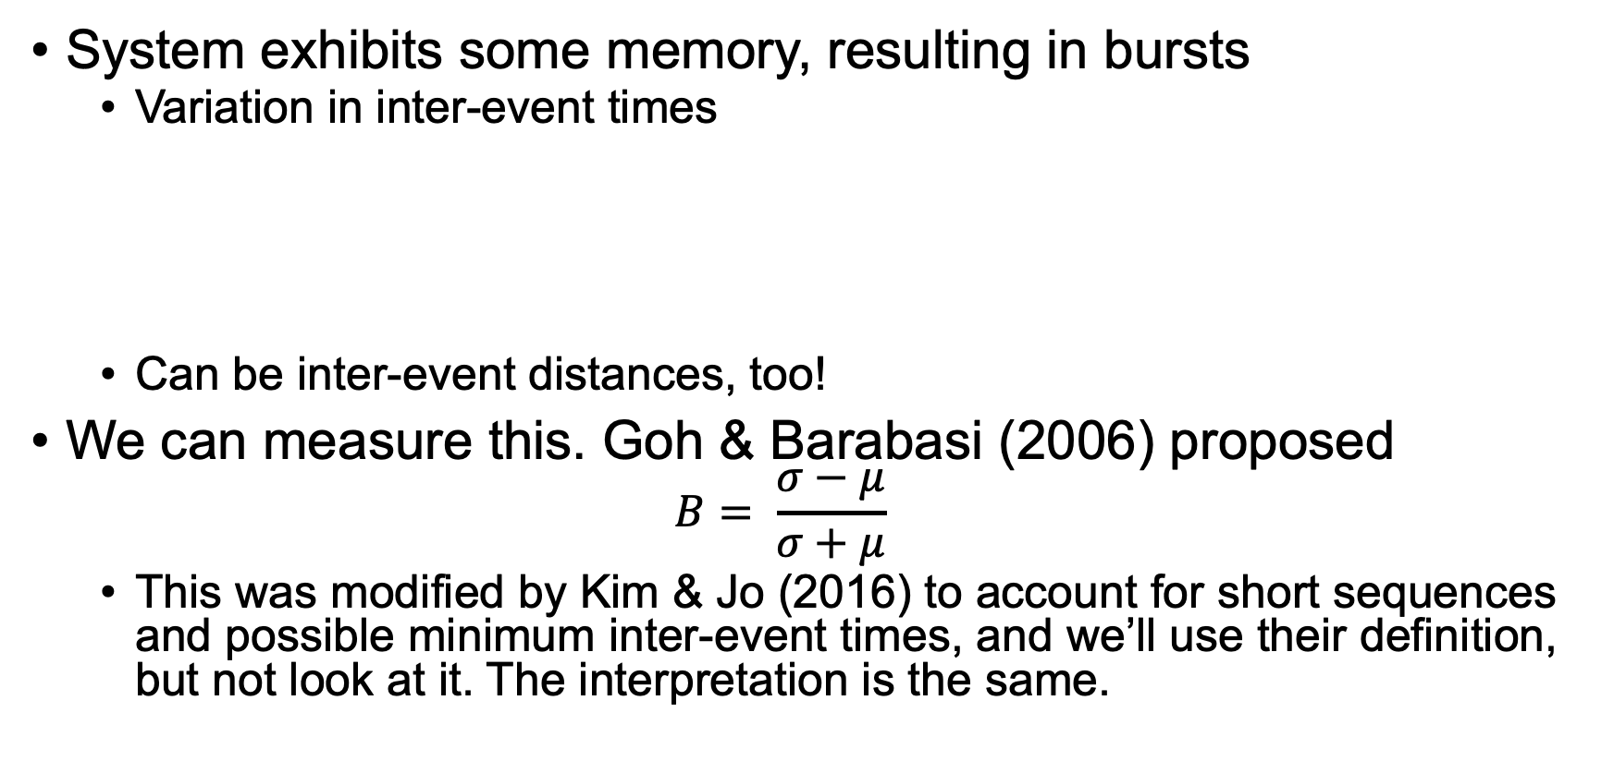
Burstiness (2:35)
System exhibits some memory, resulting in bursts
Variation in inter-event times
Can be inter-event distances, too!
We can measure this. Goh & Barabasi (2006) proposed
$$B= \frac{σ−μ}{σ+μ}$$
This was modified by Kim & Jo (2016) to account for short sequences and possible minimum inter-event times, and we’ll use their definition, but not look at it. The interpretation is the same.
Notes:
Figure from Karsai (2018), Figure 2.2.

Slide 10
Burstiness (2:40)
Interpretation
-1 is a periodic series
(-1, 0] is random behavior (typically Poisson or exponential distribution of inter-event times)
(0, 1) is bursty behavior, which implies self-organization
Can do this with code sequences
A, B, C, C, A, B, C, D, C…

Slide 11
Burstiness
Another way to fill your buffet:
devtools::install.github(…)
Must publish devtools first!
Why GitHub?
Validating to get on CRAN is a major undertaking and not always work it, especially for packages that are still in early development
Two types of burstiness, contextual vs. collective
Contextual: Particular event
Appropriate for event-based sequences (minimum inter-event time = 2)
Collective: Any event
Appropriate for time-based sequences

Slide 12
Burstiness (2:50)
Examples
burstiness(pull(read.csv("https://bit.ly/NDSSpeakers.csv")),
min_iet = 2)
Speaker data from Ricca & Jordan (under review)
CYO & Discuss (convince your partner!)
Use these datasets or your own…
NDSMacro1
Macrocognition codes data from Ricca & Jordan (under review)
Same conversation as NDSSpeakers
NDSAFAR
Data from an AFAR analysis of a self-video; codes are identified emotions. (Harwell et al., under review)
Comparing NDSpeakers & NDSMacro1
Are speakers bursty? Are codes? What might that mean?

Slide 13
An Interlude: Shapes (3:15)

Slide 14
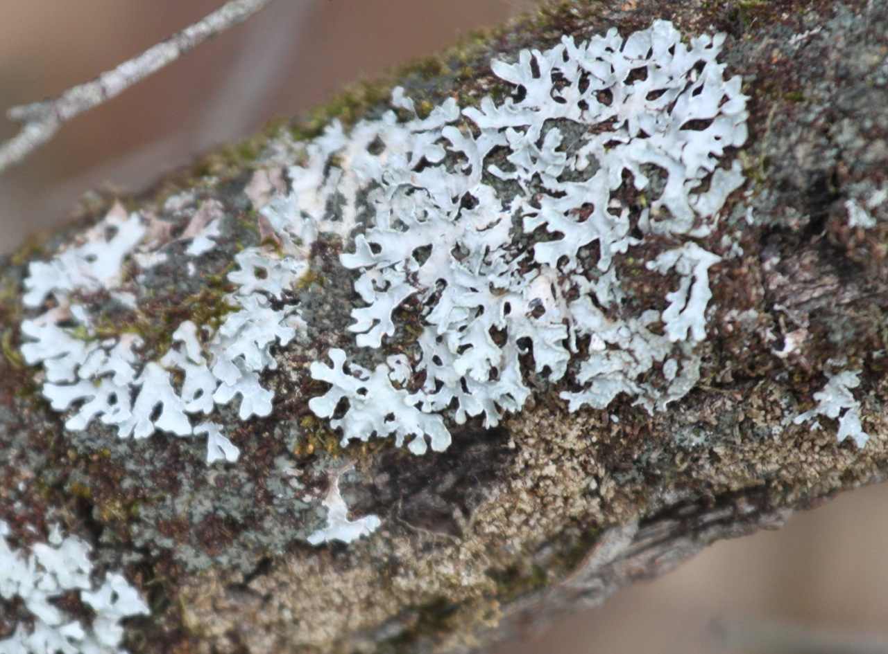
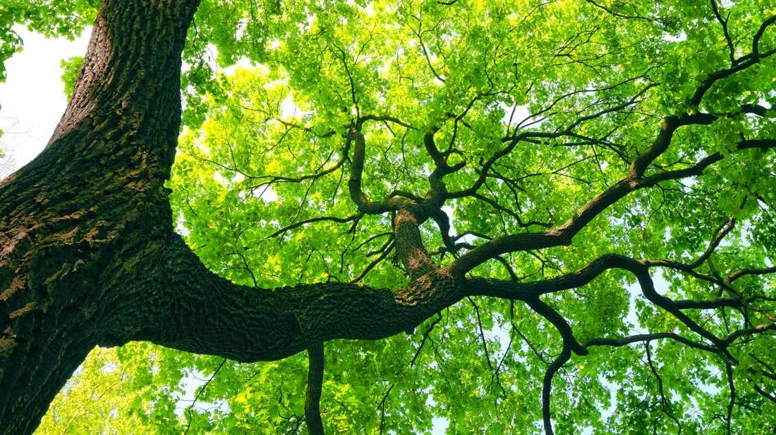
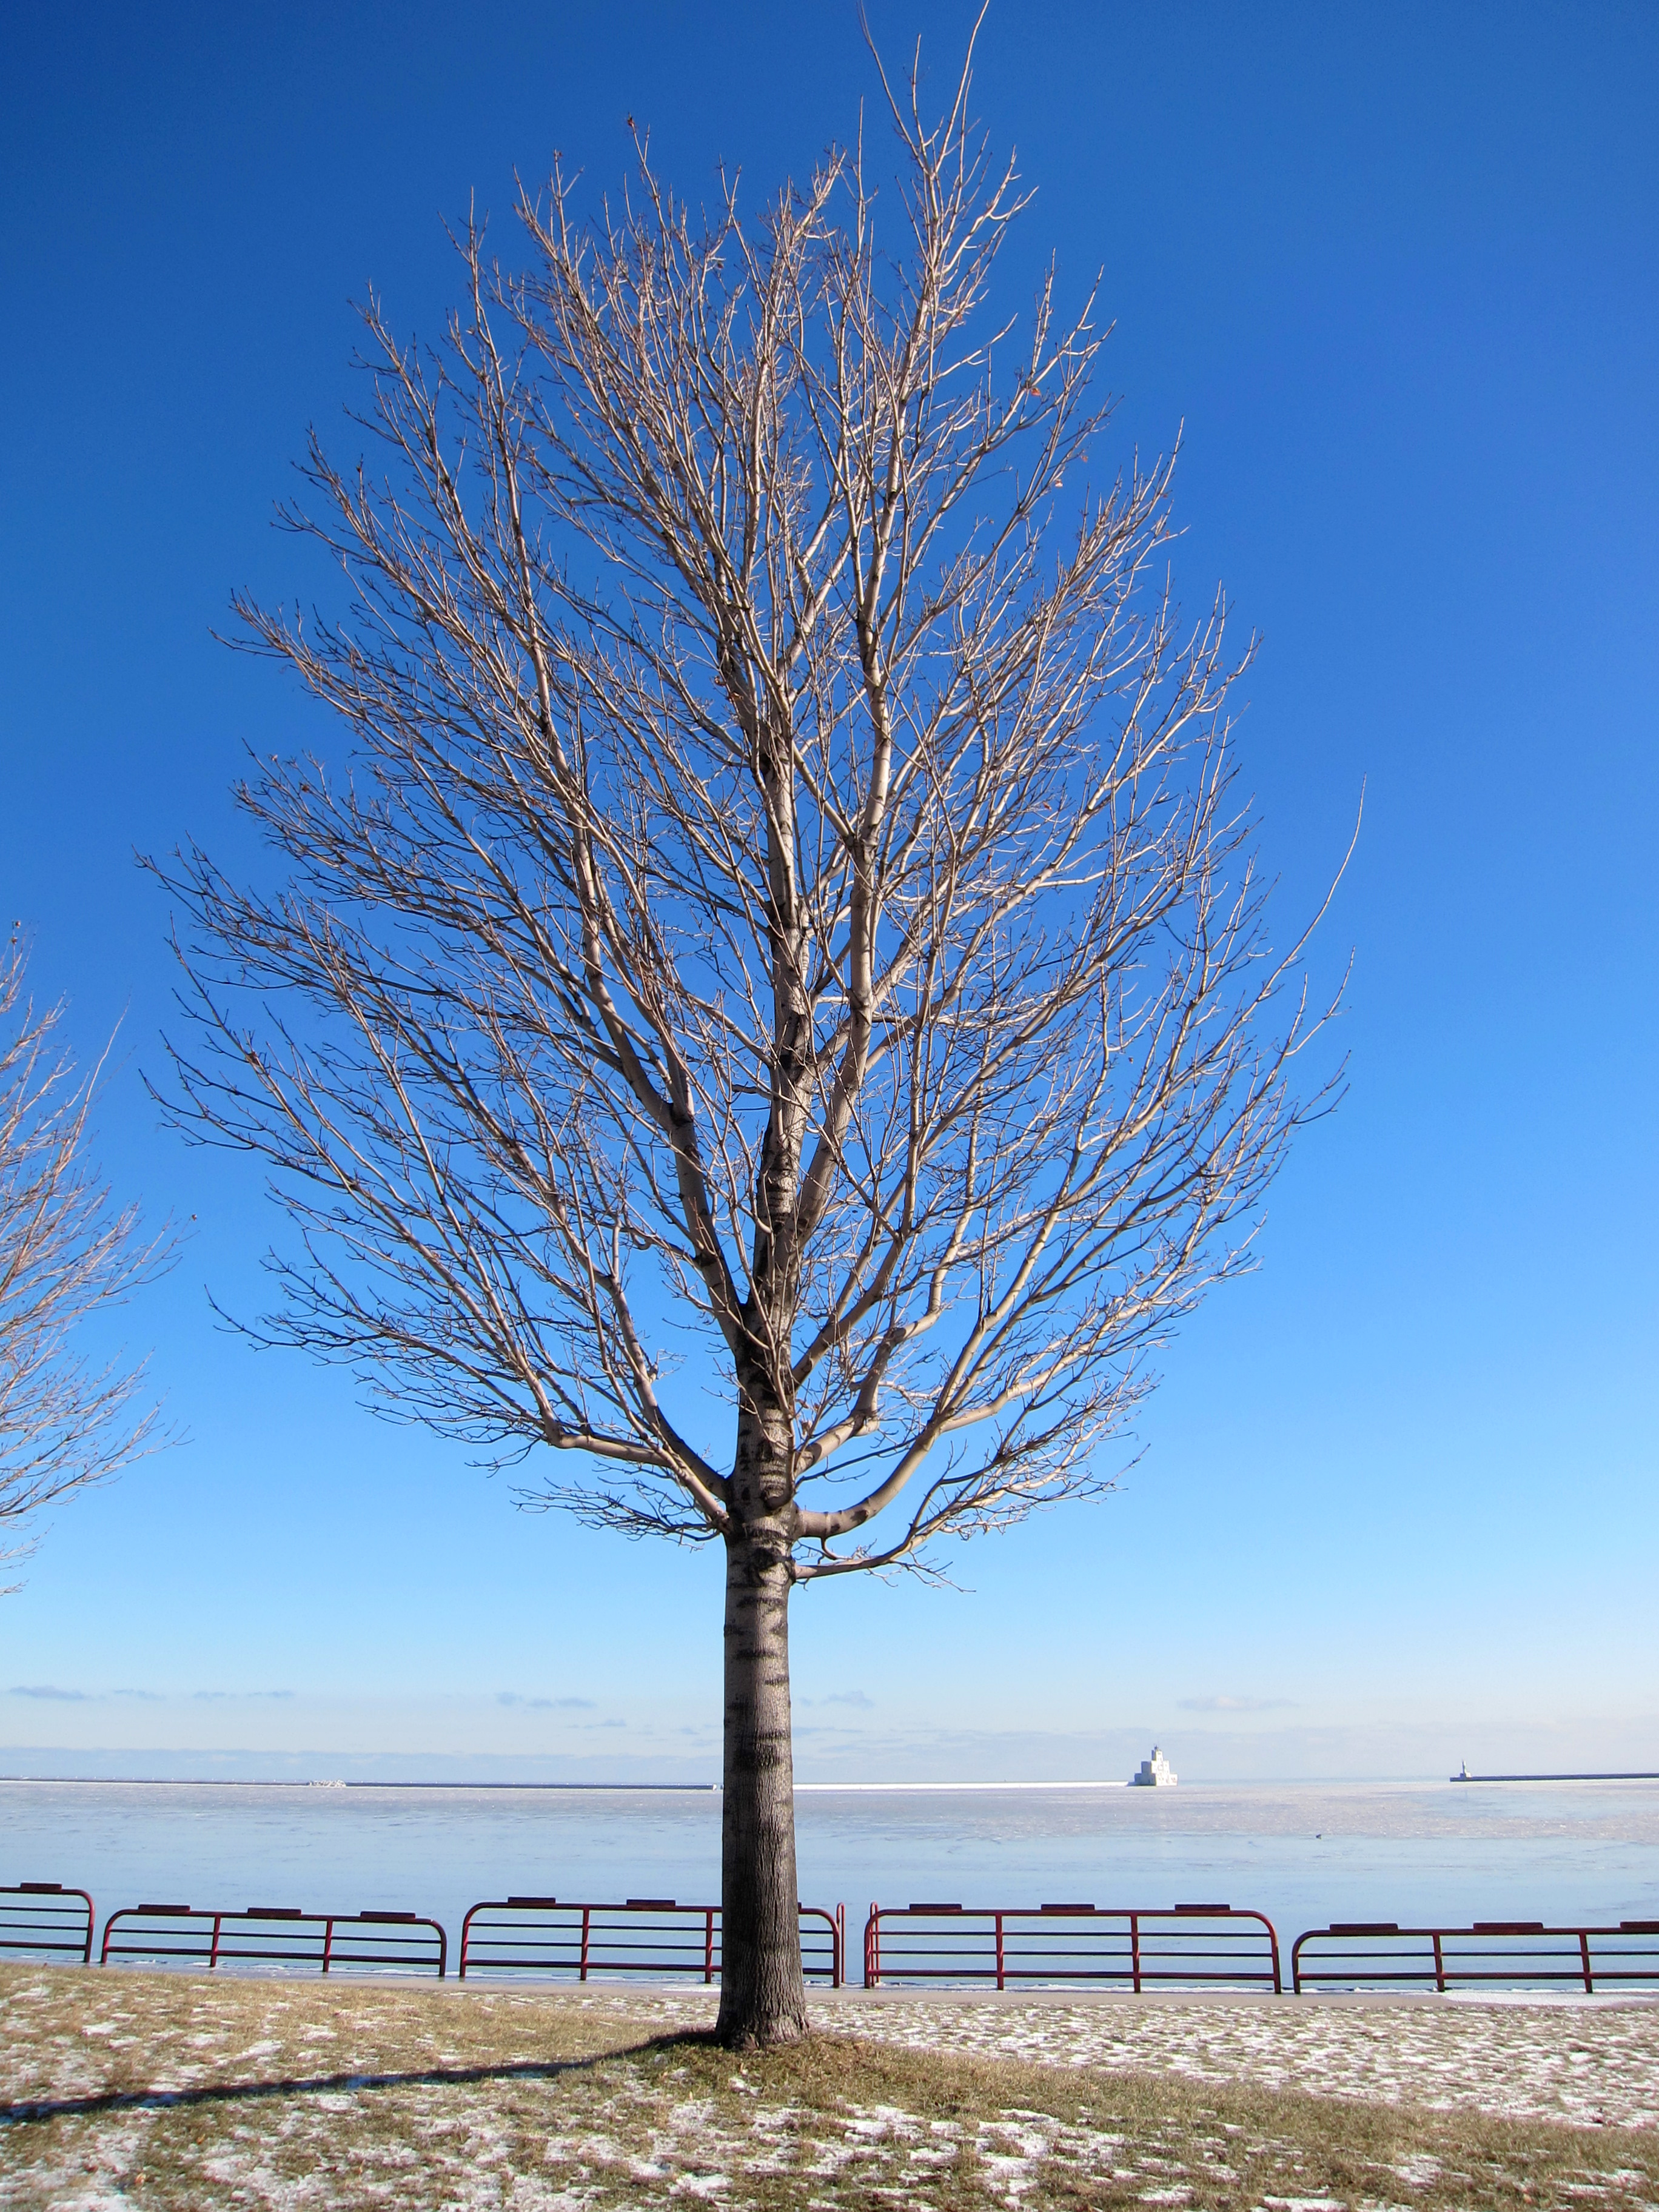
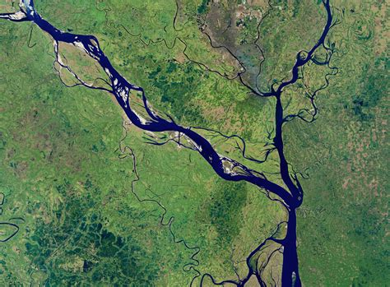

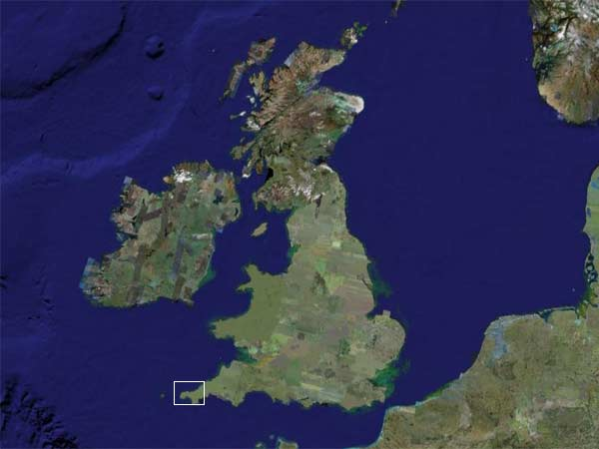
Shapes (3:15)
Give some examples of different shapes
Notes:
Put examples on white board.
Then, post photos here
What differences do you see? Describe them. (My answer: Self-organization is governed by something other than high school geometry.)

Slide 15
Shapes – my summary (3:25)
High School Geometry
Exogenously determined shapes!
Human engineered & constructed
2-dimensional (or 3-dimensional)
The Natural World
Similarity at difference scales
Grown, not engineered
Fractional dimensions(!)
Benoit Mandelbroit – “fractals”
Notes:
What do all of these have in common?
Many answers, including: They are human-constructed and their shape is determined exognenously

Slide 16
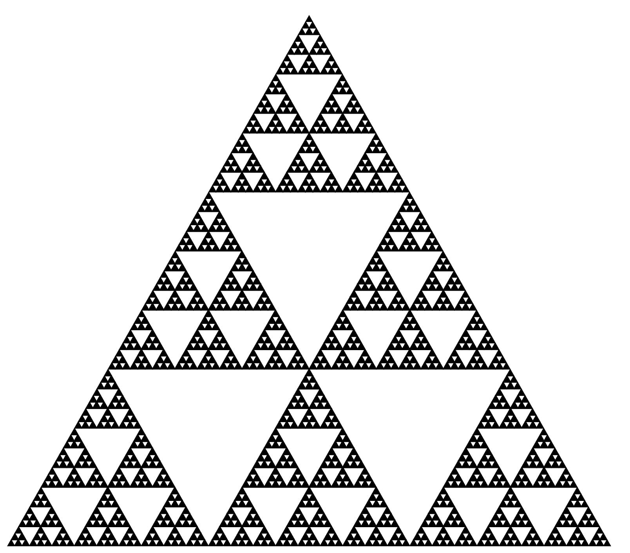
Sierpinski Triangle (3:45)
Describe this figure
How would you make it?
Notes:
Describe this.
How would you tell someone to make it?

Slide 17
Making a Sierpinski Triangle (3:55)
Two ways of doing making it
Removing triangles
Recursive (self-operating…as opposed to iterative)
Sierpinski game
Constrained random:
Start anywhere
Roll a die: 1&2 go halfway to blue vertex, 3&4 go halfway to green vertex, and 5&6 go halfway to red vertex
Repeat
This is how a lot of CGI works, incidentally

Slide 18
Sierpinski Triangle (4:05)
How much is left at each step?
Step | Scale | Fraction Remaining
1 | 1 | 1
2 | ½ | 1 – ¼ = ¾
3 | ¼ | ¾ - (¼ * ¾ ) = 9/16
4 | 1/8 | 9/16 – (1/4 * 9/16) = 27/64
5 | 1/16 | 27/64 – (1/4 * 27/64) = 81/256
6 | 1/64 | 81/256 –(1/4 * 81/256) = 243/1024

Slide 19
Area: Triangles and Sierpinski Triangles (4:10)
We’ll do some plots: NDSTriangle
plot(x,y)
Log-log plot
plot(x,y,log = “xy”)
Linear regression of the log-log variables
lm()
summary(lm())
Dimension! (Yes, it really works)
Now, do all this with NDSSierpinski
Wow! Fractional dimensions
“Fractals” – Mandelbrot

Slide 20
Self-similarity (if time)
The same at multiple (all) scales
Statistical self-similarity vs. actual self-similarity
Real data isn’t such a perfect fit
When is anything real a perfect fit?
Same process, though
Many things are self-similar
City maps
Circulatory system
Tree branches
Coastlines
Notes:
This slide is in the Tuesday morning stack

Slide 21
Dimension (if time)
There are many different dimensional measures
Geometric
Box counting
Lines
Hausdorff
Etc., etc.
Be sure you are consistent in your use
All are similar in their approach
Notes:
This slide is in the Tuesday morning stack

Slide 22
CYO & Discuss (if time)
Plot and find the dimensions
Crumple paper
Whole sheet, then half sheet, then quarter sheet, etc.
NDSPaperCrumple
Discussion
Constrained random? Endogenous? Meaning of dimension?
Notes:
This slide is in the Tuesday morning stack too…

Slide 23
Wrapping Up (4:25)
Please take the two-question survey
Give one good thing about today’s sessions
Give one thing that could have improved today’s sessions
Link: https://bit.ly/MondaySurvey

